Slide 1
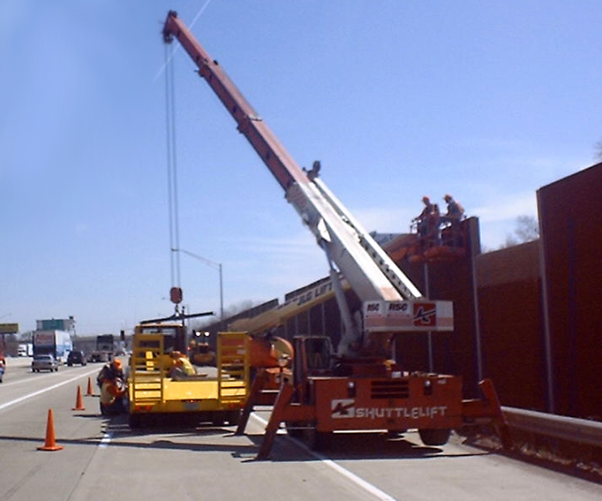
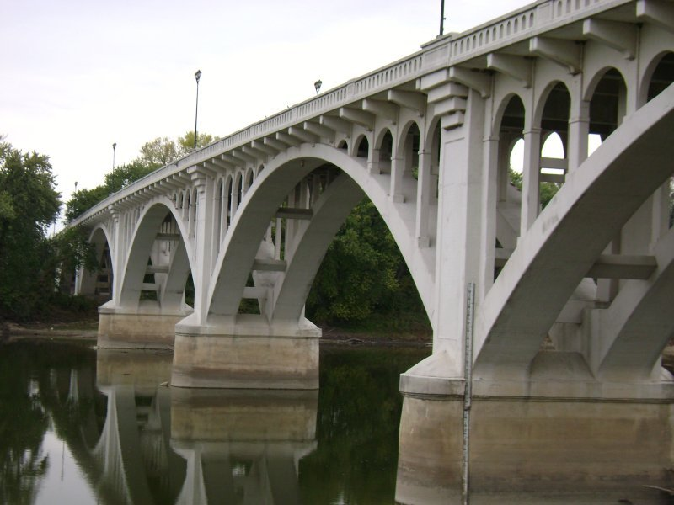

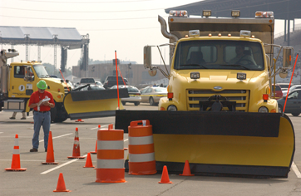

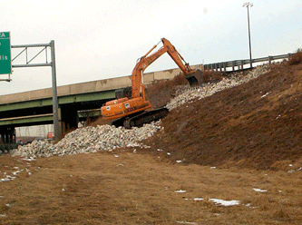
2019 TRB Transportation Application Conference
Session P10
Developing Visions for Indiana Statewide Corridors
Roy Nunnally, Director
INDOT Asset Planning & Programming
Johnny Han, Technical Vice President
The Corradino Group
June 4, 2019
Notes:
1

Slide 2
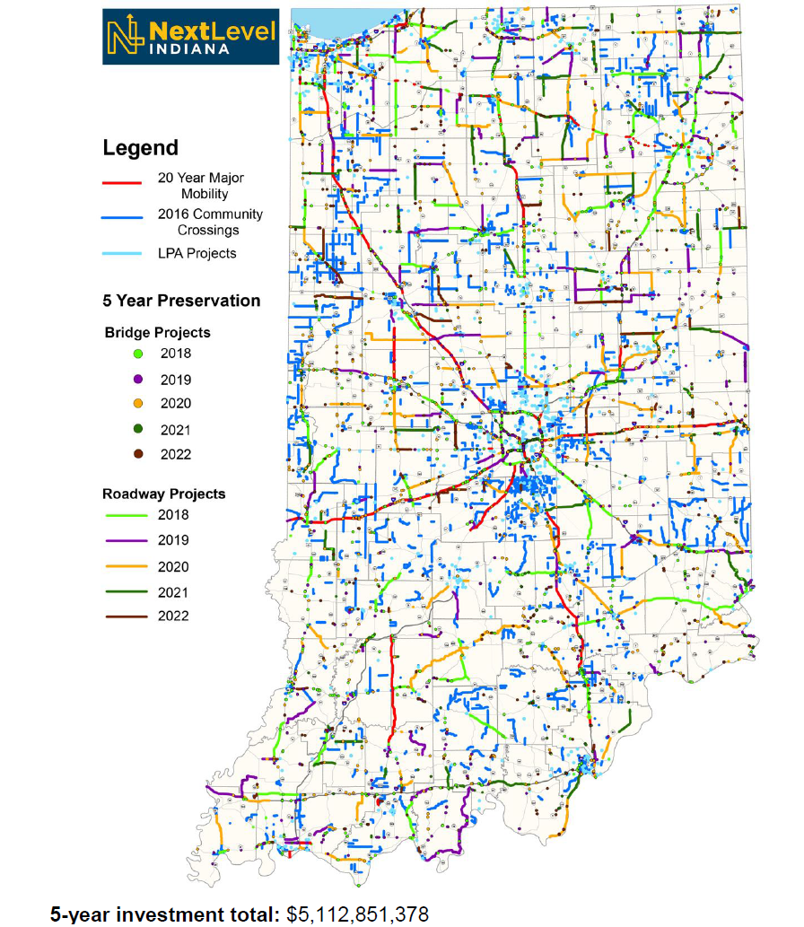
Study Purpose
Supports the 20-Year, $30B Indiana Next Level Roads Program
Preservation of existing roadway infrastructure
Supplement the agency’s existing, non-project specific, future year transportation needs report http://www.in.gov/indot/2666.htm;
Develop intermediate and long-term corridor visions & performance goals for state jurisdictional roadway facilities for enhanced comprehensive transportation planning.
Link to other asset management, planning, and program documents
Involve extensive early coordination and outreach with key stakeholders and the general public.
Allows for a more comprehensive look at needs and solutions
  Local Economic Development & Land-Use Planning
  Intermodal System Connectivity
  Multi-Mode Considerations
  Access Management Planning

Slide 3
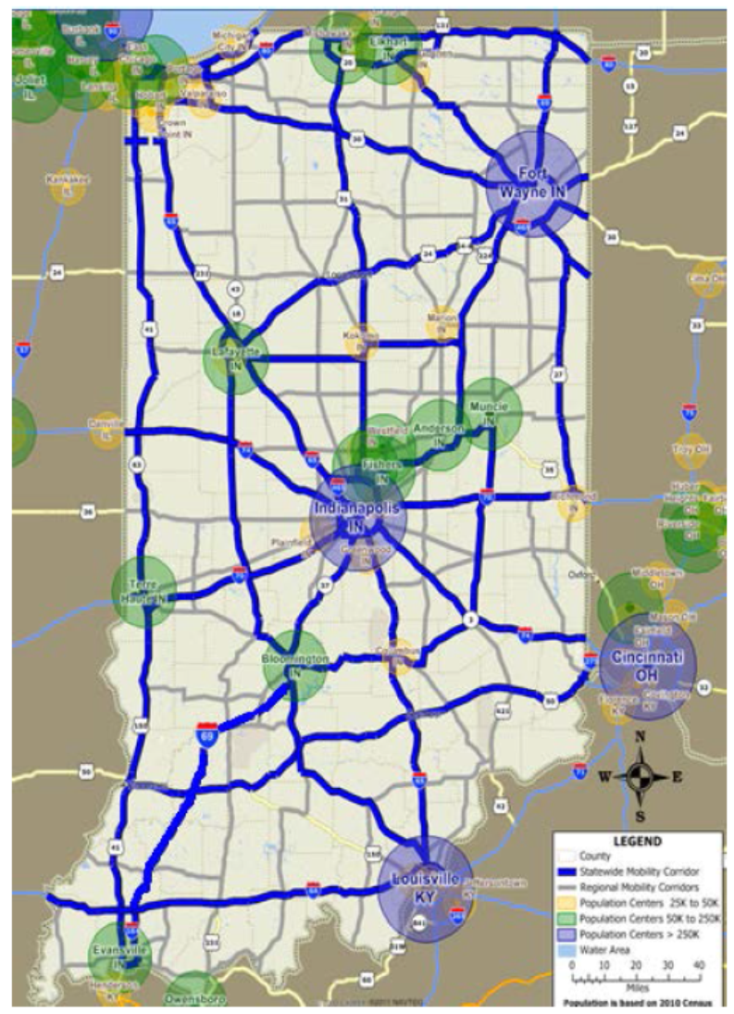
Corridor Selection
Started with Statewide Mobility Corridors
3-Tiers Hierarchy
Statewide Mobility
Regional Mobility
Sub-Regional
Input in from District and MPOs

Slide 4
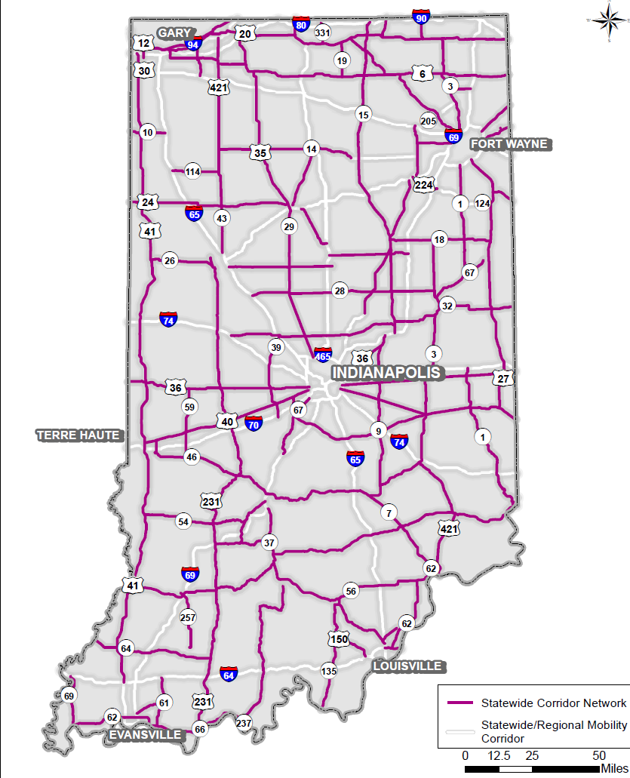
Statewide Corridors To Be Evaluated
66 Corridors Identified (55 mile average length), 137 Segments (average length 26 miles)
Coordinated with District & MPO Partners
Focused on Statewide Mobility Corridors across the state
  Excluded:
    Interstates
    Active Corridor Studies (e.g. I-69/SR 37, SR 37 Hamilton Co., US 31, and US 30
  5-additional corridors were included

Slide 5
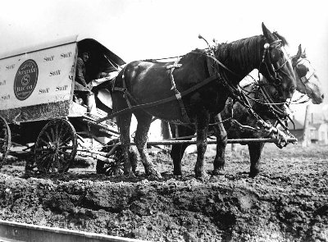
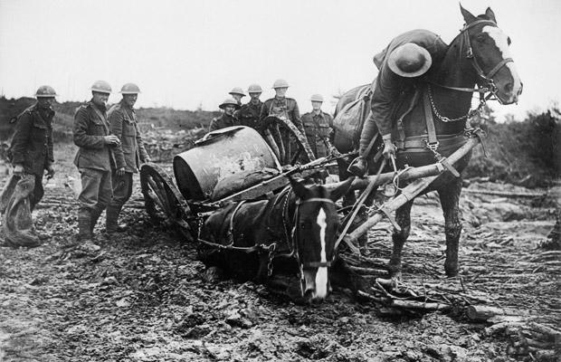
Why Corridor Vision Planning?
Support asset management to protect our investments
Considers access management opportunities to preserve corridor performance and safety
Allow for corridor protection and protective ROW purchasing
Image Source: Conner Prairie Travel & Transportation
Things Change! Encourages a complete investigation of various strategies, including non-transportation strategies, such as land use planning and zoning
Plan for the future - guidance for future infrastructure and corridor development improvements
Image Source: Churchill’s Mission to Rescue War Horses

Slide 6
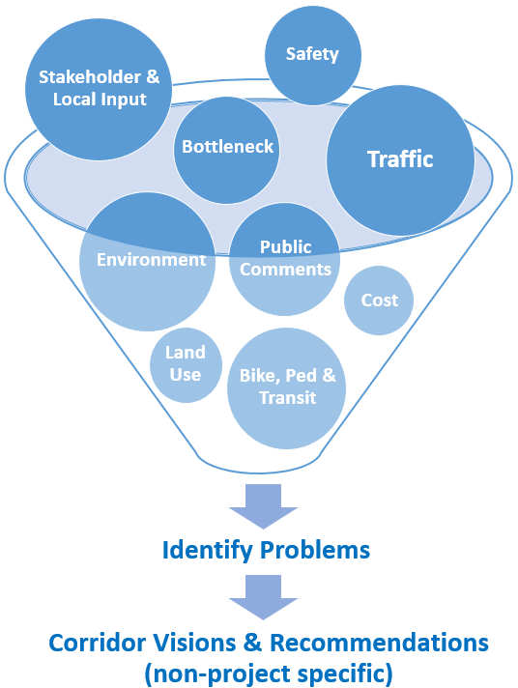
Corridor Analysis
Planning-Level Analysis Covering the Following Topics:
  Traffic/Truck Movements & Growth
  Traffic Capacity Analysis
  Bottlenecks
  Travel Time Reliability
  Safety
  Transit
  Bike & Pedestrian
  Land Use Impact
  Environmental
  Improvement Strategies
  Cost estimation
  Stakeholder Outreach
  Public Involvement

Slide 7
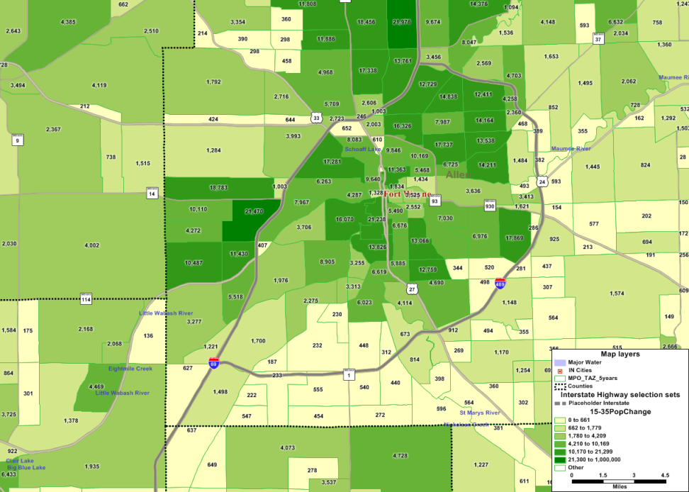
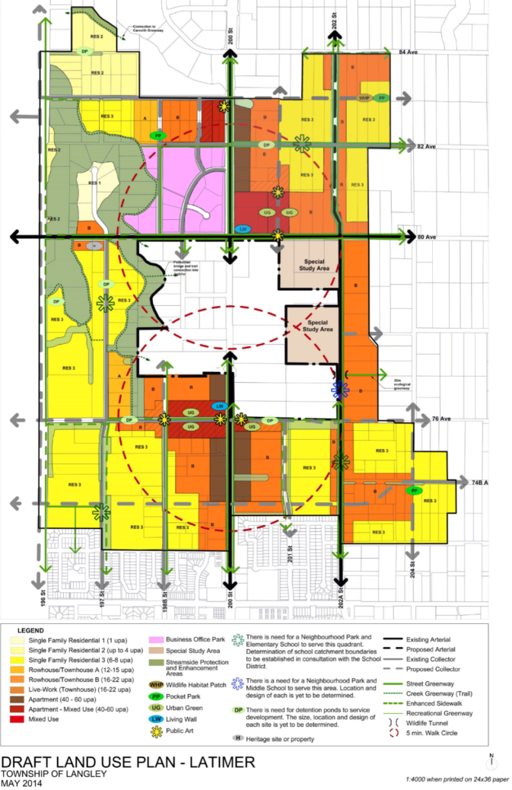
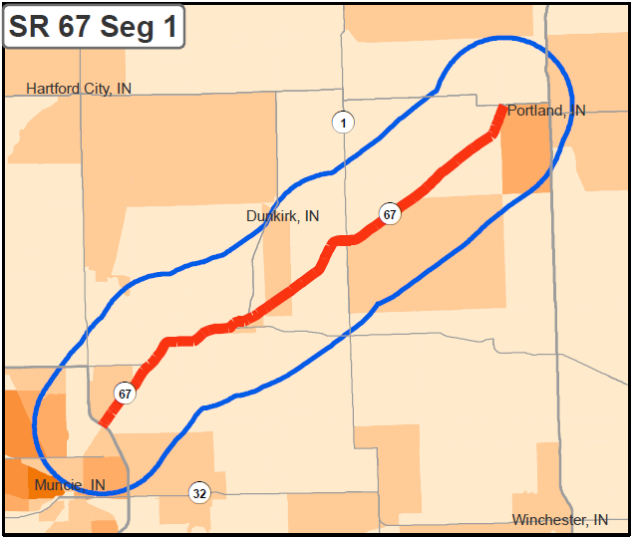
Land Use Consideration & Planning
Study looks at 30-year changes
Where will people live, work, & shop?
How will land-use change?
How demographic changes will impact travel patterns?
3-mile buffer used around corridor segments
Population & employment growth shown in general categories: low, med, & high

Slide 8
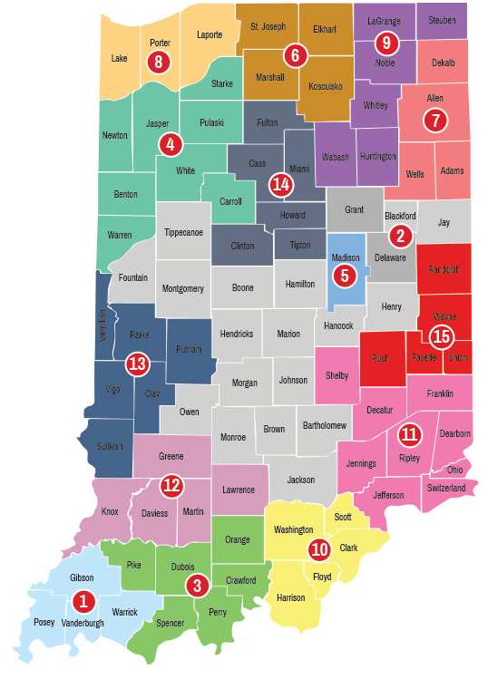



Leveraging Relationships & Partnerships
Multi-Modal, Asset Management Departments, FHWA, FTA, EPA
State Agencies: Department of Environmental Management, Economic Development Corporation, Public Health, Natural Resources, Tourism, and Homeland Security
Citizens, Stakeholders, Elected Officials, and Special Interest Groups, Indiana Economic Development Corporation

Slide 9
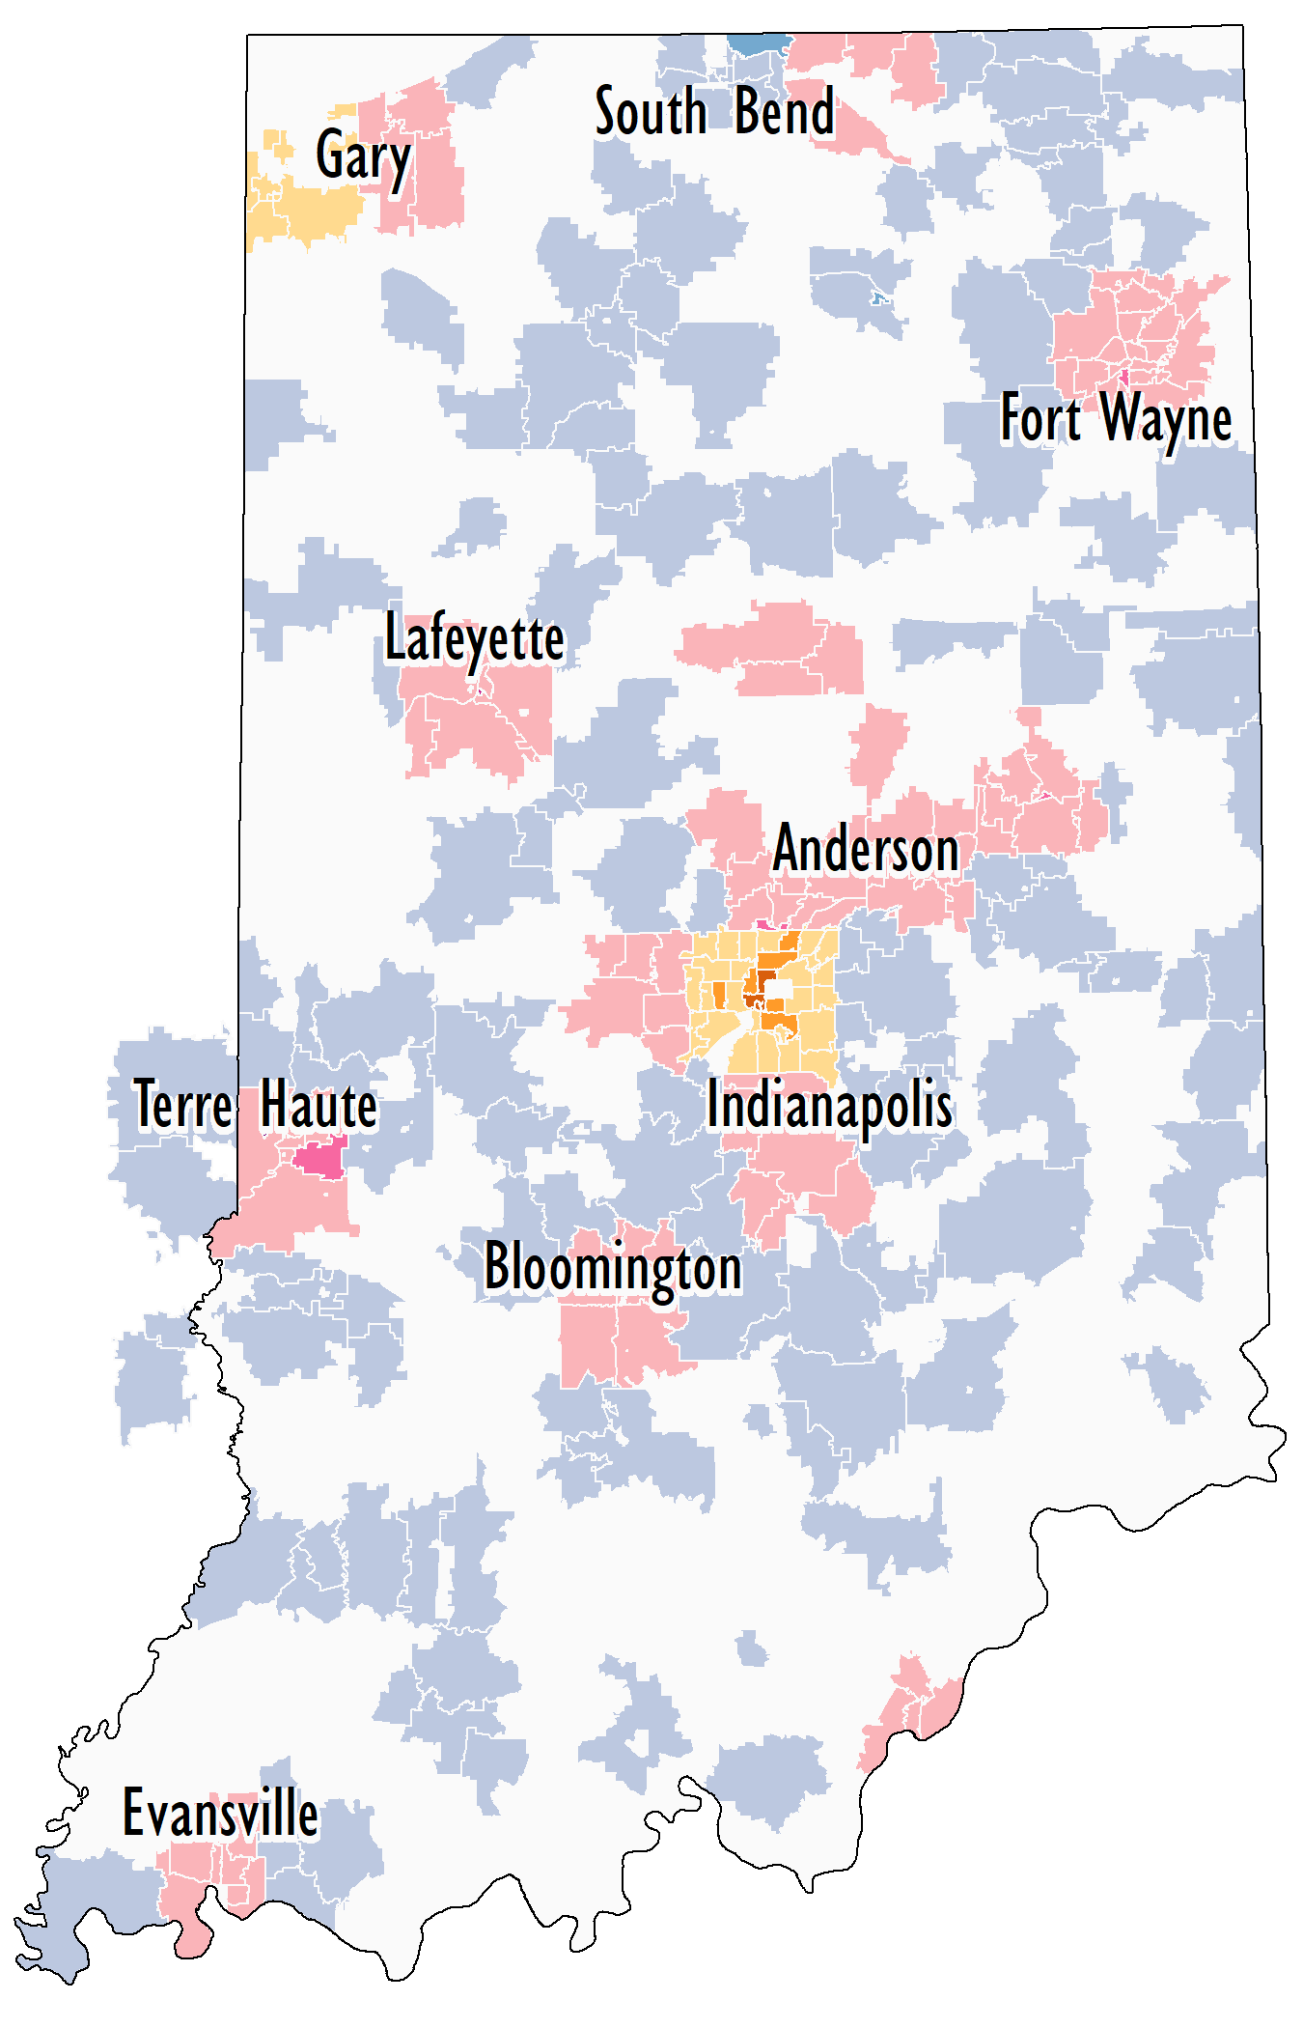
Extensive Outreach: Active Transportation Survey
Over 2,500 Survey Responses
 |  | Responses/SqMi
 |  | <2 | 2-5 | >5
Type* | Urban
 | Suburban
 | Rural
*Assigned at county level using 2010 US Census Classification

Slide 10
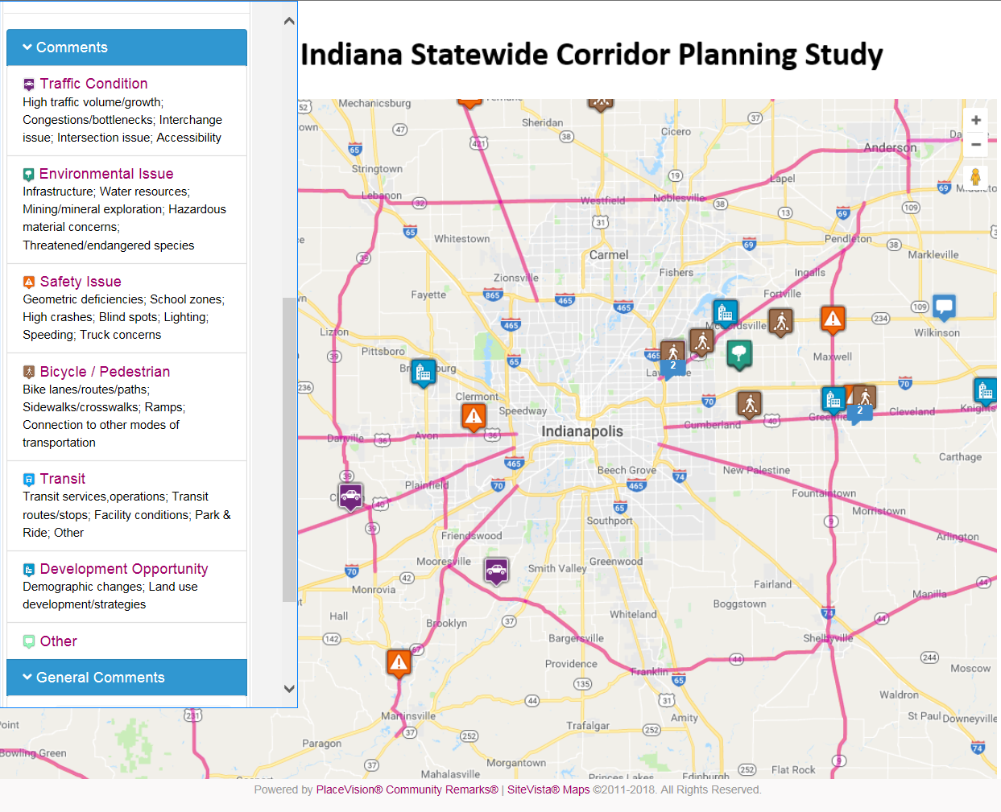
Community Remarks Citizens Engagement Map
Crowdsource outreach opportunities
Collects comments, responses, and votes
Allows others to see and support issues submitted
Mobile Friendly
Google Map Background for familiarity
Geocoded comments can be exported to other map applications
User can select multiple languages for increased outreach
More information here https://communityremarks.com/indiana/
Use Agency & Personal Social Media to Get the Word Out

Slide 11
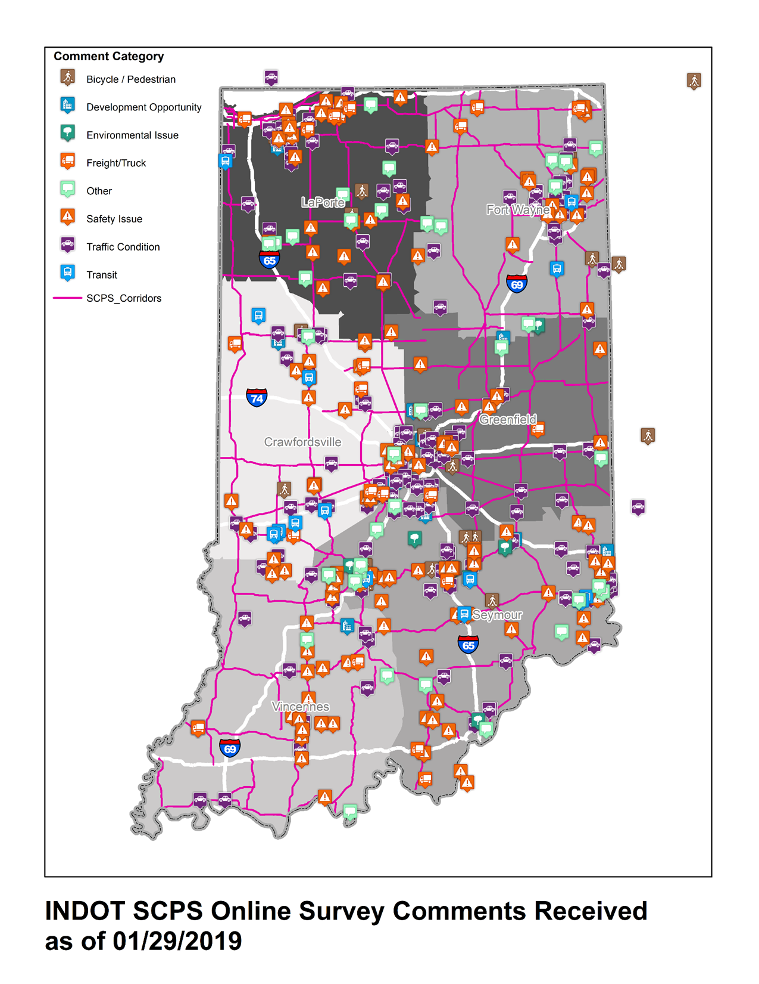
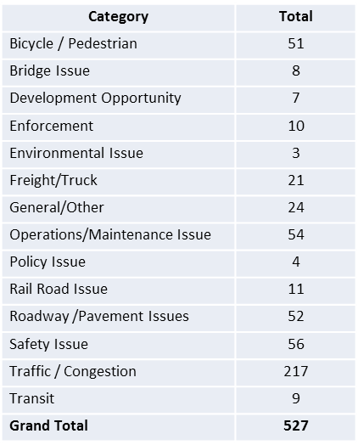
Only Survey Results: Statewide
527 Comments Received from 12/14/18 to 2/2/19
69% comments were on state facilities
274 responders left their contact information

Slide 12

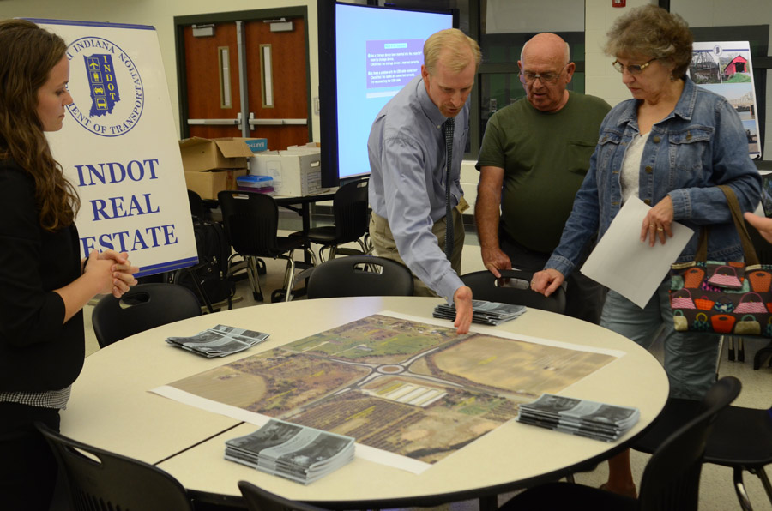
Regional Planning Coordination Meetings
7-Regional Meetings November-January with 114 Participants
  Metropolitan, Regional, District, and Federal Transportation Partners
  Local Elected Officials & Board Members
  Economic Development Stakeholders
  Manufacturing representatives
Bringing stakeholders & partners to the table
  Discuss the annual call, programmed projects, new and missed transportation improvement opportunities
  Discuss land use, economic development, transformative technologies, and initiatives and potential impacts to the transportation system
  Share and discuss ideas, coordinate projects, transportation related needs, corridor visions, and solutions
Image Source: InkFreeNews

Slide 13
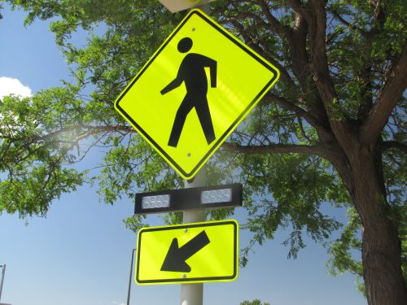
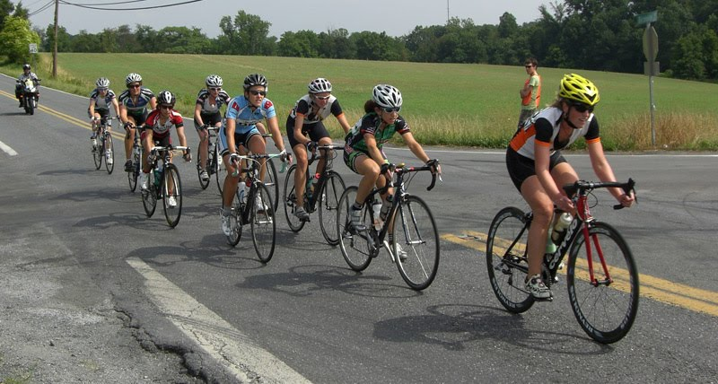
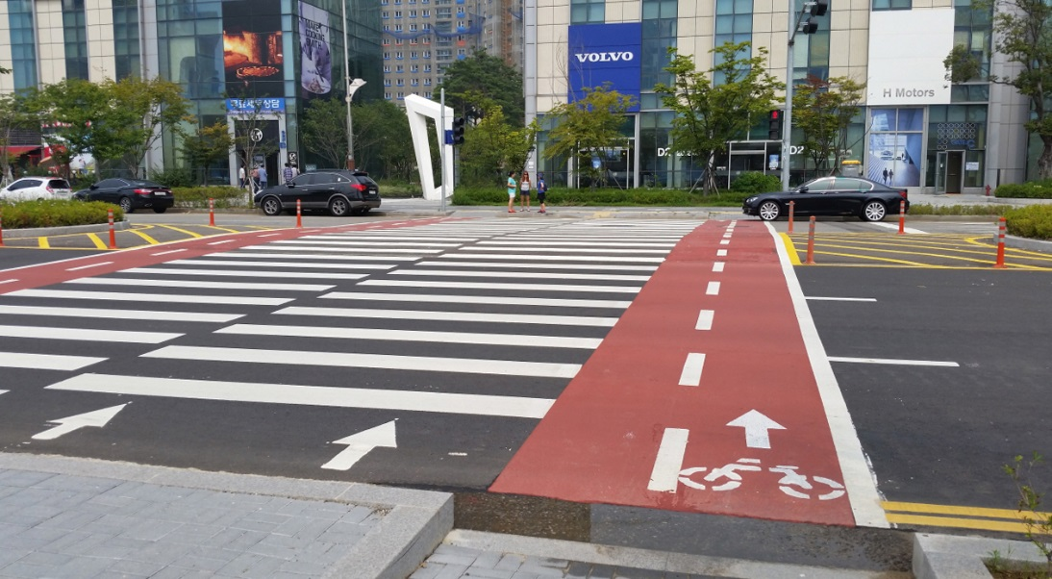
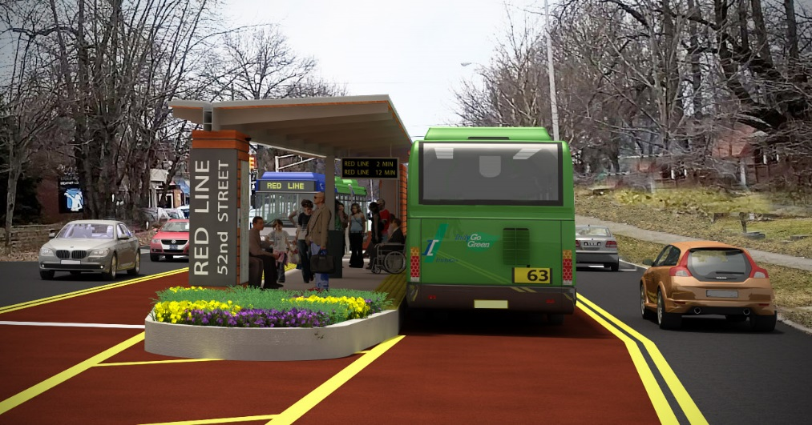
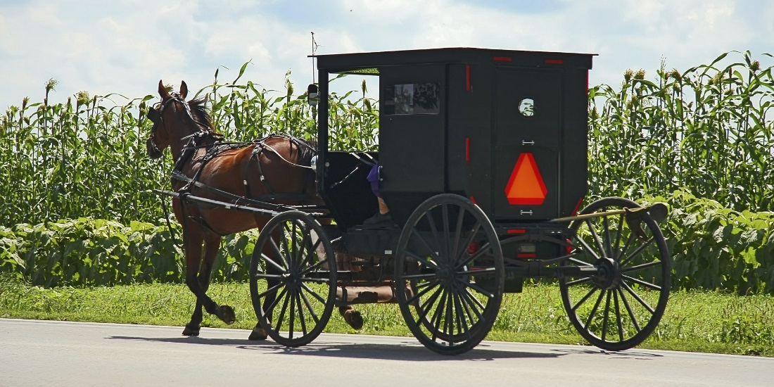
Multimodal Coordination

Slide 14
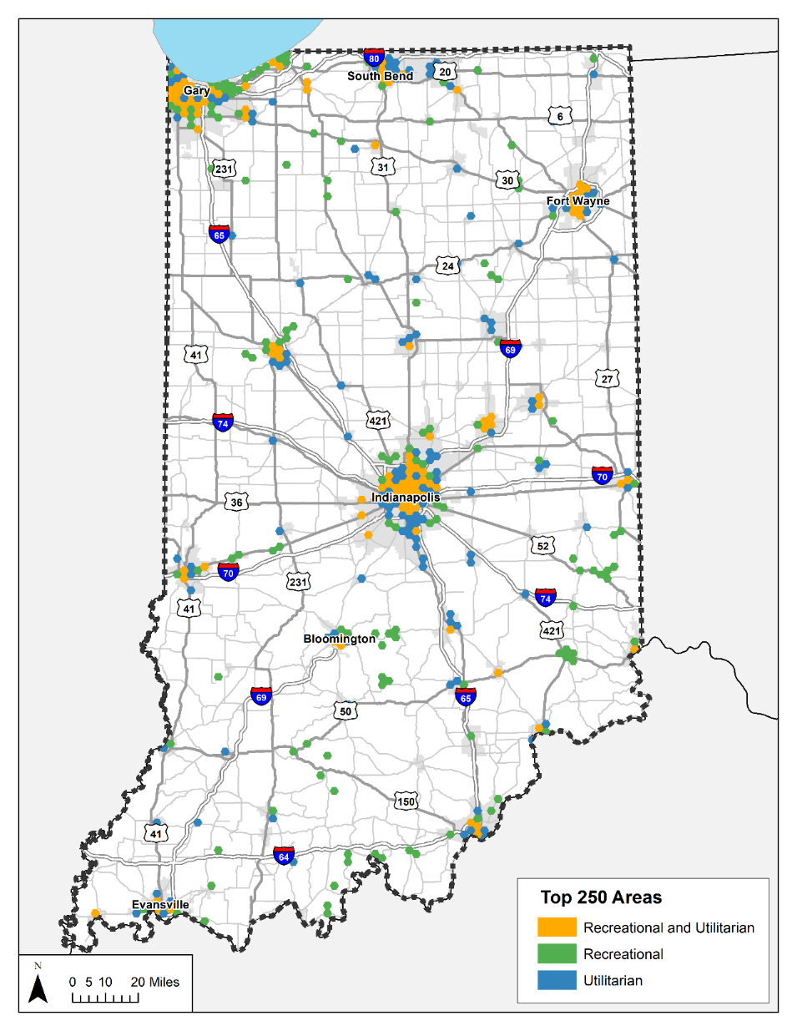
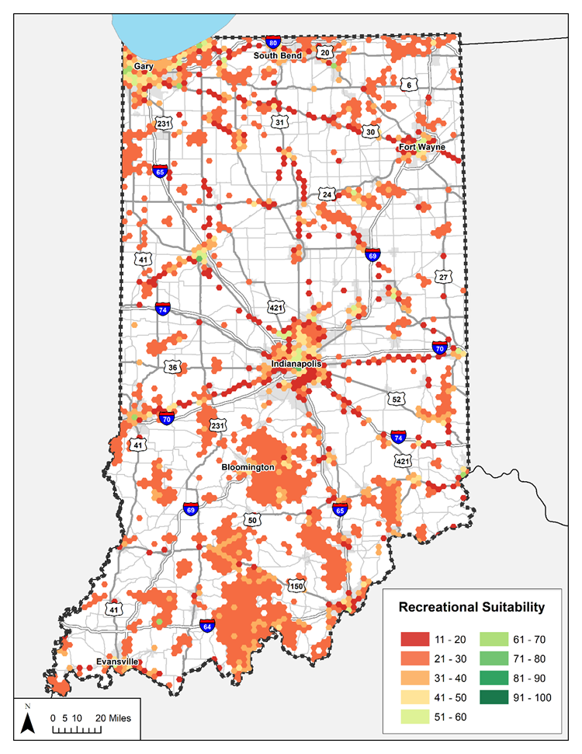
Recreation Vs. Utilitarian Bike Trips
Recreation Demand Results
Top 250 locations (instead of 100).

Slide 15
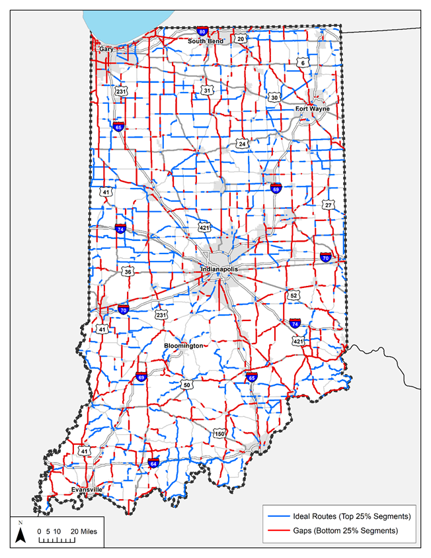
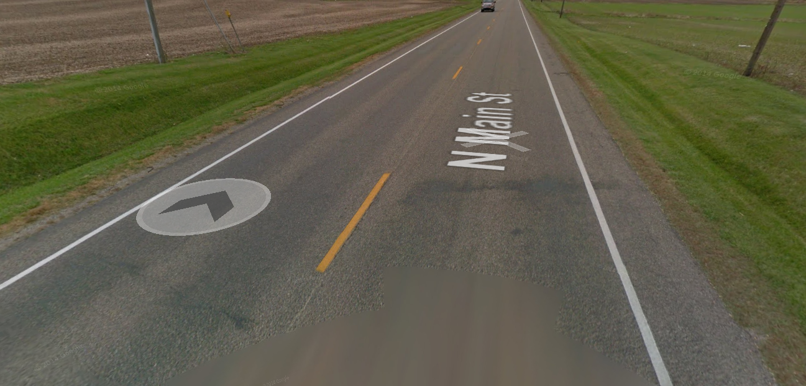
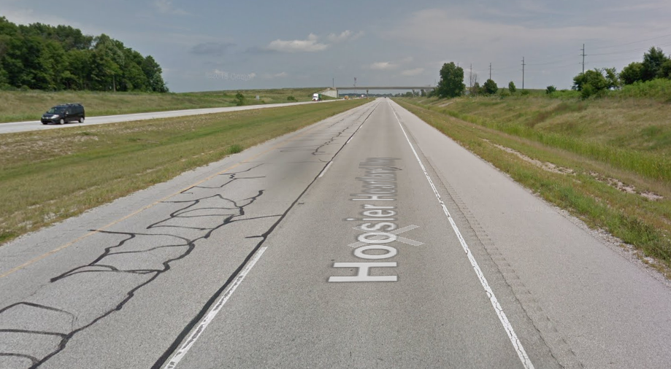
Bicycle Network Suitability
“Rates” the suitability of state highway network for active transportation
Slight shift in suitability from north to south
Function of shoulder presence, traffic volumes

Slide 16
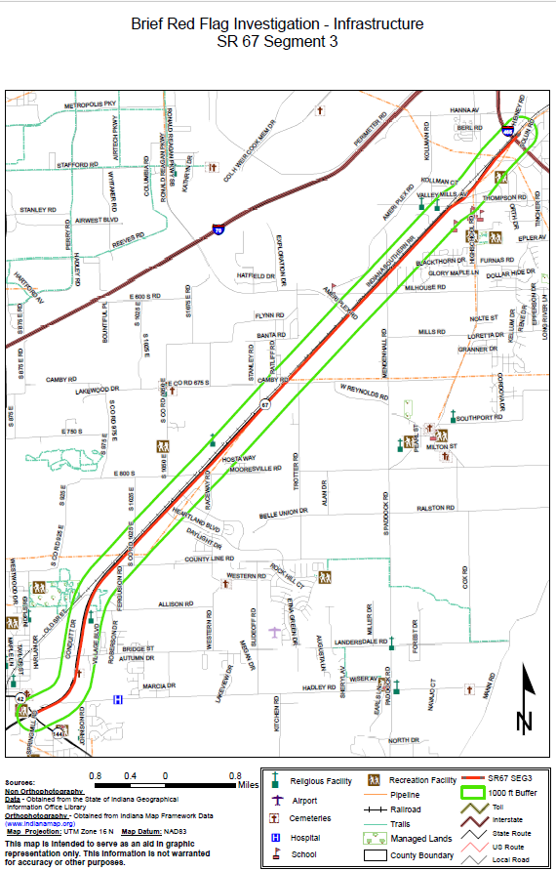
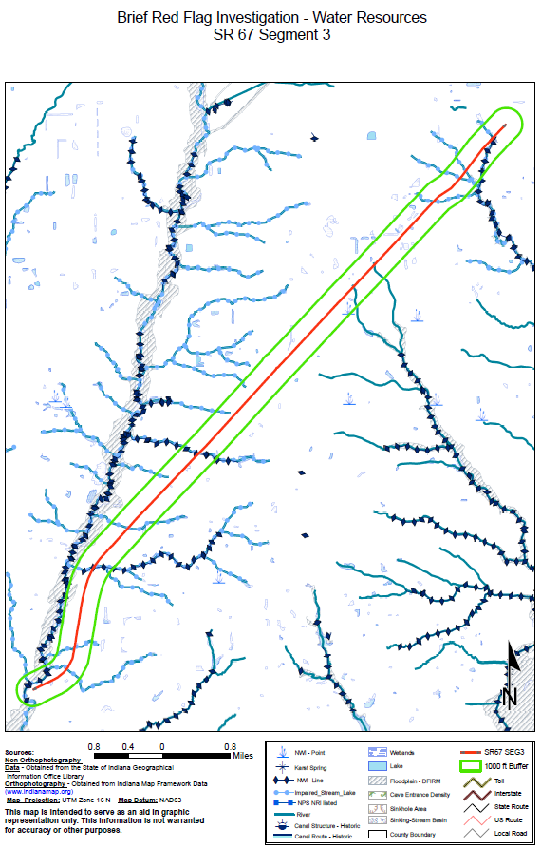
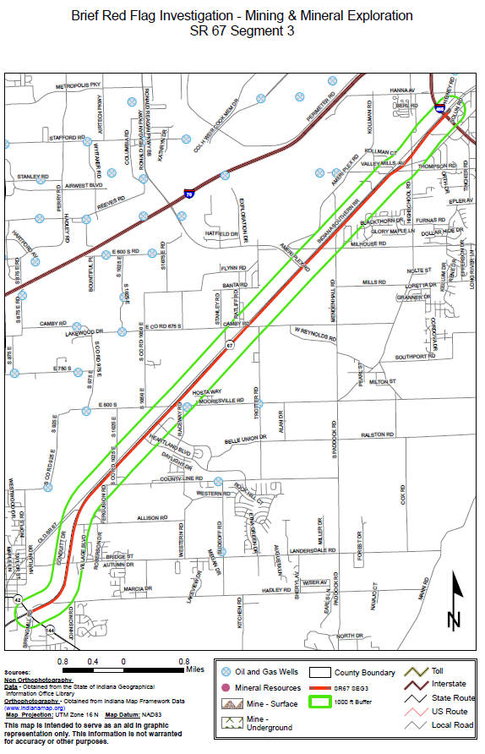
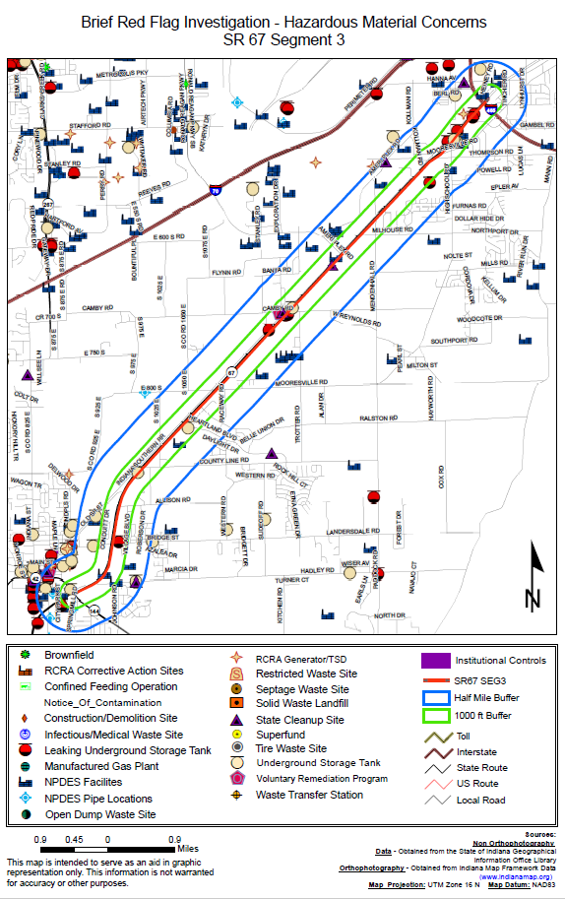
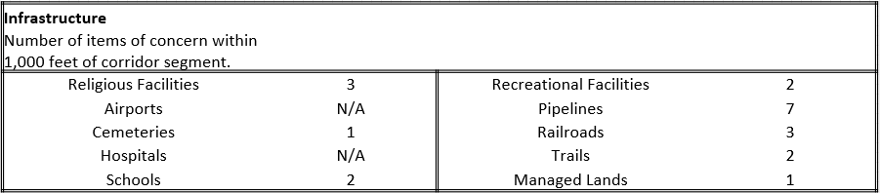
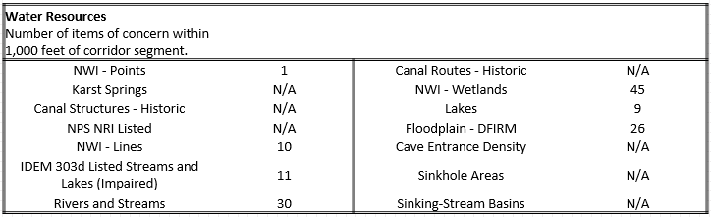
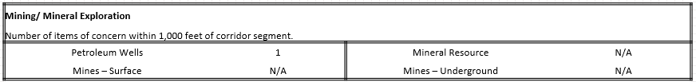
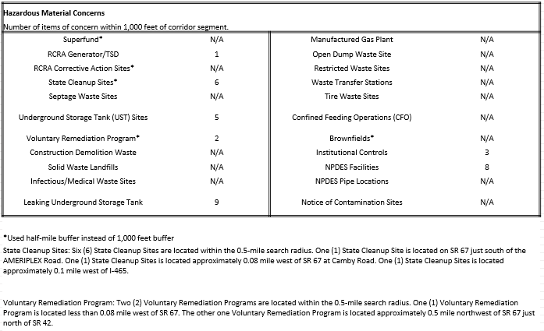
Environmental Red Flag Investigation Analysis
Preliminary Red Flag Investigation (RFI) analysis

Slide 17
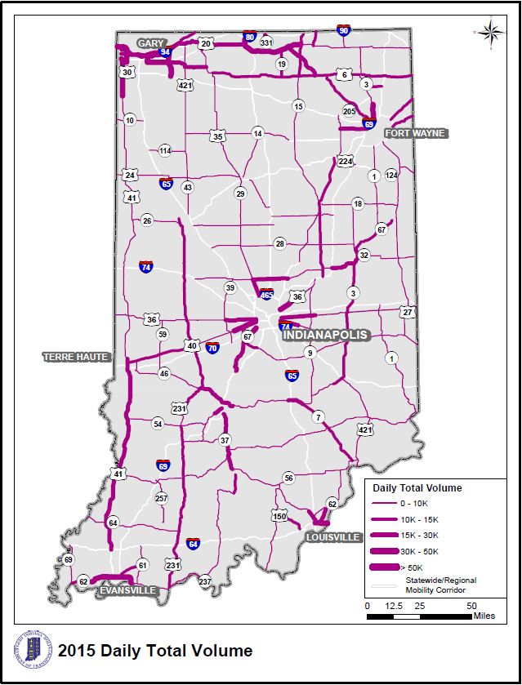
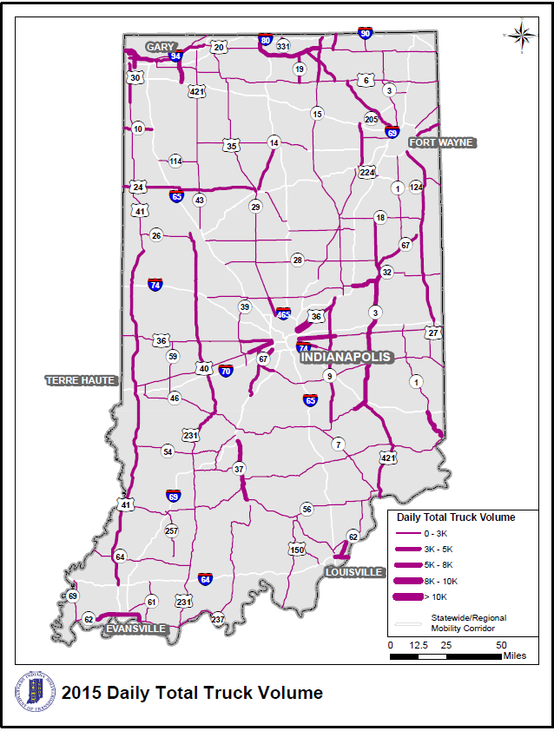
Network Analysis: Traffic Flow
ISTDM7 model runs with updated socioeconomic data (2015, 2025, 2045)
Average traffic flow is summarized by corridor segment
Total Traffic
Truck

Slide 18
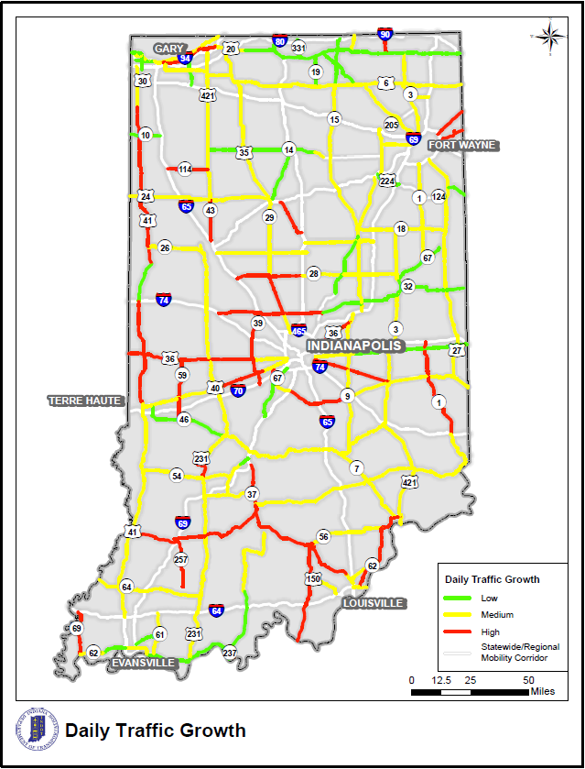
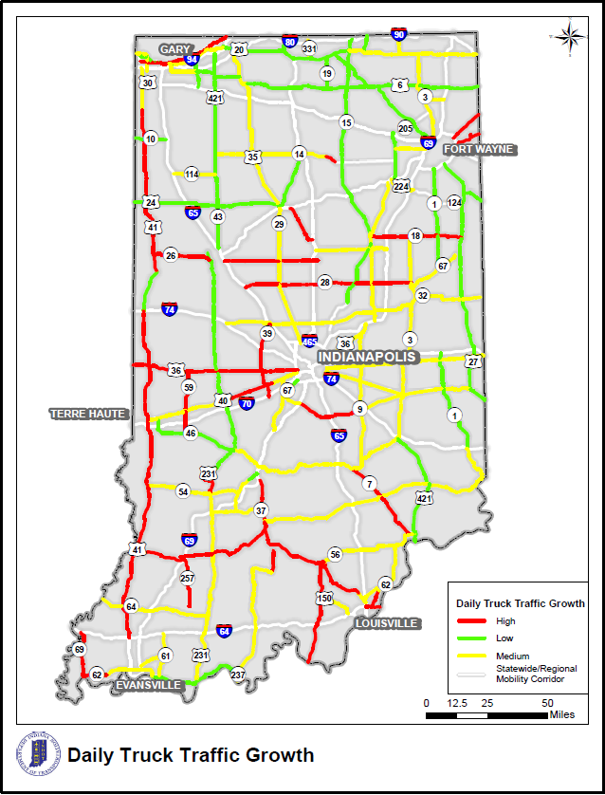
Network Analysis: Traffic Growth
INDOT & MPO Models provided growth rates
Traffic growth shown in general categories: low, med, & high
Total Traffic Growth
Truck Growth
Adjustments have been made to a few corridor segments through stakeholder coordination.

Slide 19
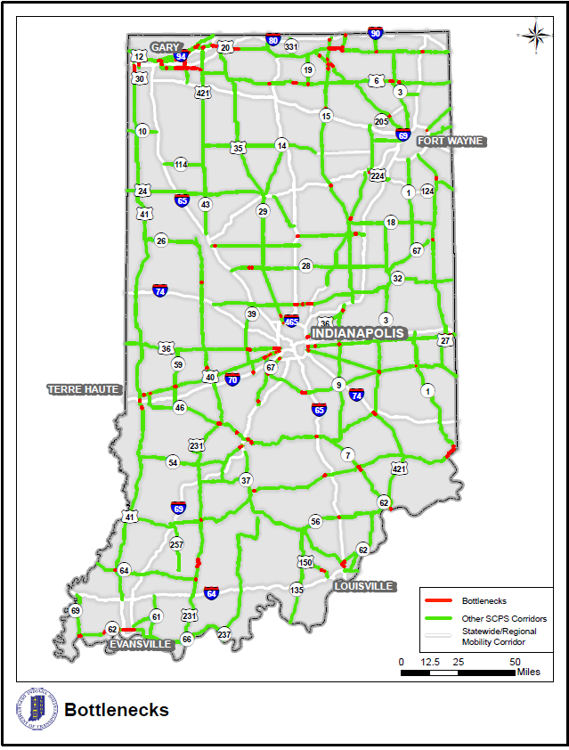
Network Analysis: Bottlenecks & Congestion
Bottleneck Identification
  ISTDM volume/capacity ratio (2015 & 2045)
  INDOT’s truck bottlenecks (INDOT Freight Plan 2018)
  NPMRDS data used to determine Level of Travel Time Reliability (LOTTR)
Florida DOT method used for capacity analysis at planning level

Slide 20
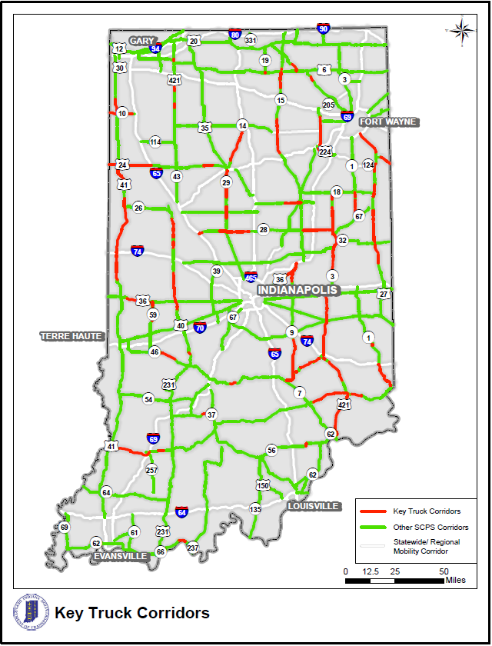
Network Analysis: Truck Corridors
  Coordination with INDOT Freight Team
  Truck% greater than 40% (2015 ISTDM data)
  Daily truck volume greater than 500 (2015 ISTDM data)
  FHWA’s Primary Highway Fright System (PHFS)
  Note: Interstates are not included in this study.

Slide 21
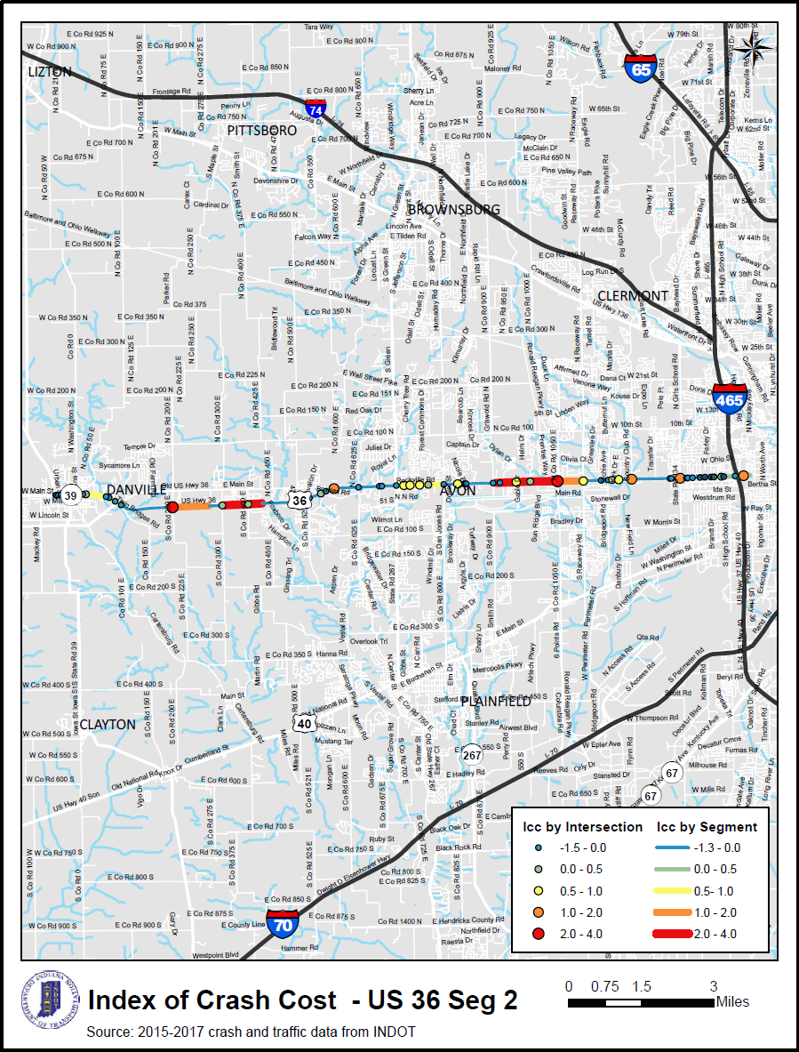
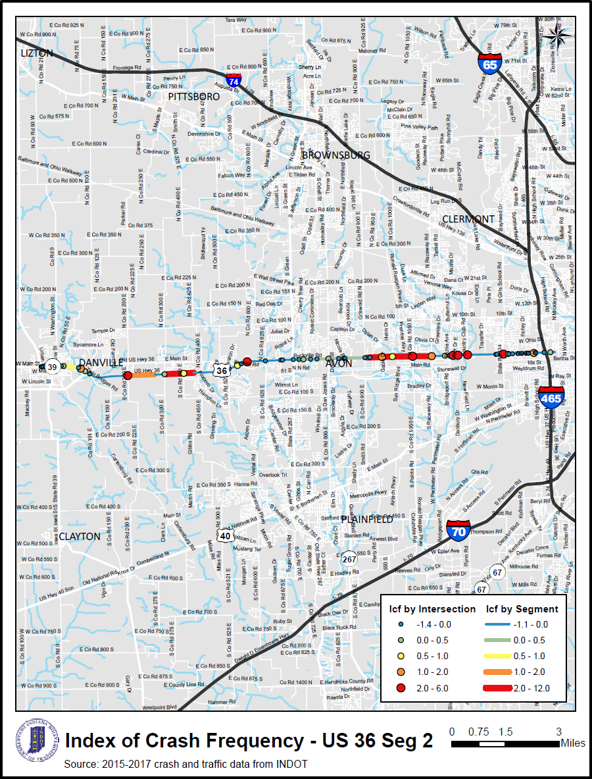
Network Screening: Safety Analysis
Acquire data & develop methodology by coordinating with INDOT
INDOT 2018 Network Screening Tool
I_{CC} (Index of Crash Cost), I_{CF} (Index of Crash Frequency)

Slide 22
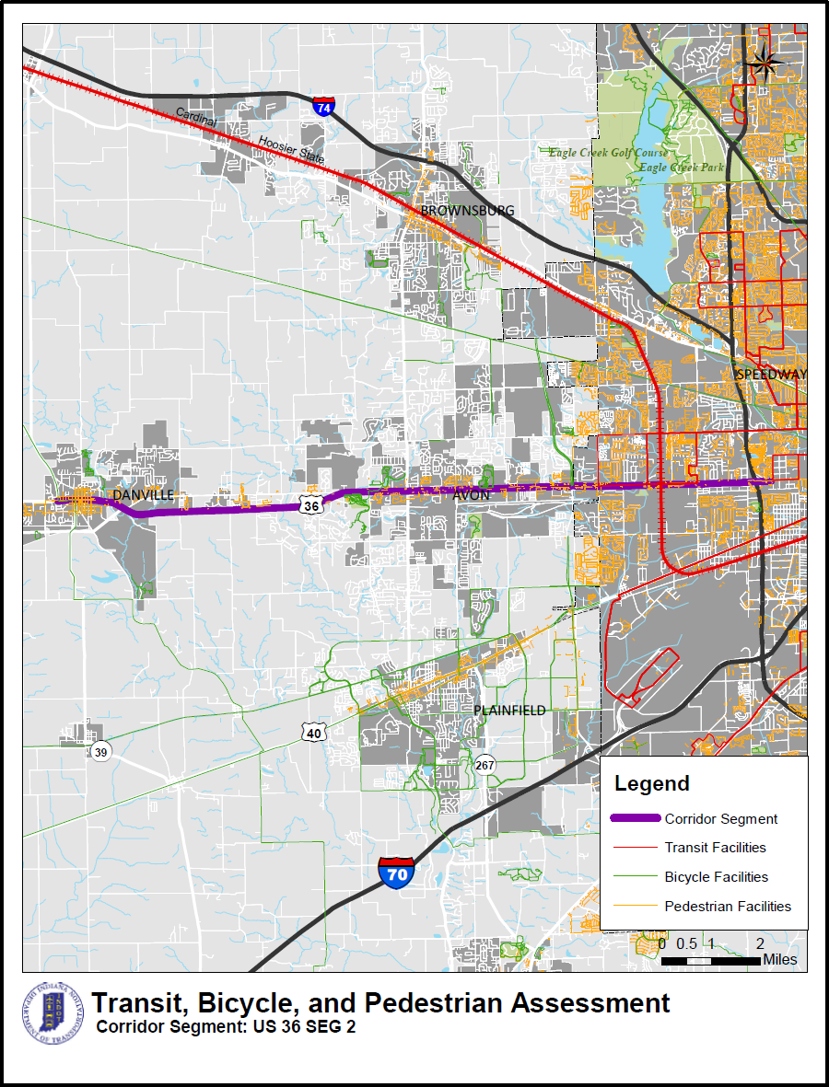
Transit/Bike/Pedestrian Needs Assessment
Extensive coordination with INDOT and MPOs to acquire GIS layer data
Mapping of Transit / Bike / Ped facilities along corridor segment
Evaluation of network connectivity (Low, Average, High)

Slide 23
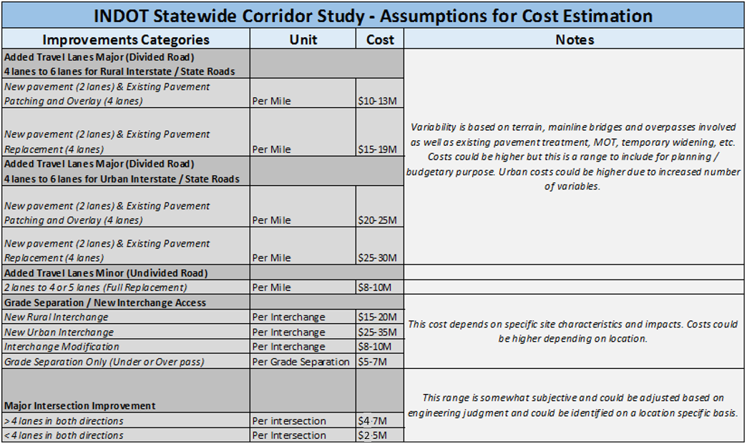
Network Improvement Strategies & Cost Est.
Coordinate with INDOT to develop improvement categories and cost ranges at preliminary planning level.

Slide 24
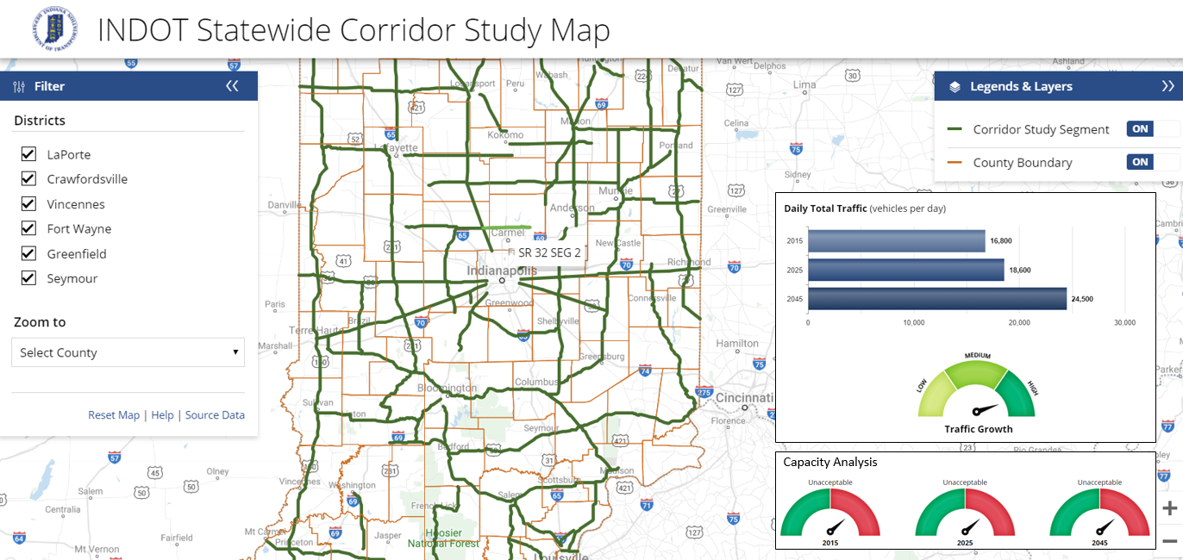
GIS On-Line Tool Demonstration
Corridor Profile (behind)
  An Excel database of study corridors
  Easy to maintain & update
  “Dynamically” read by ArcGIS Online
ArcGIS Online (front)
  Interactive map showing study corridors
  Ability to access Corridor Profile via internet and smart devices
  Open for INDOT’s continuous maintenance and update
  Draft version available now

Slide 25




Thank You!
Contact:
Roy Nunnally
rnunnally@indot.in.gov
Johnny Han
jhan@corradino.com

